Slide 1
Invertible

Slide 2

Unique Invertibles

Slide 3
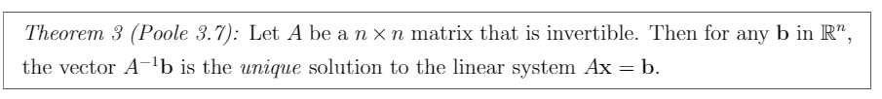
Invertible Unique Solution

Slide 4

Invertible Homogenous Solution

Slide 5
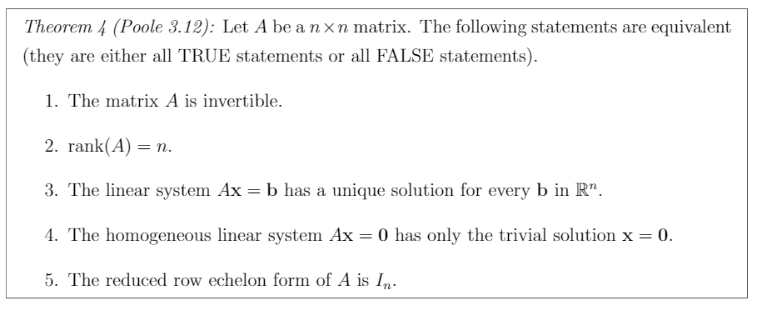
Invertible Properties
Fundamental Theorem of Invertible Matrices

Slide 6
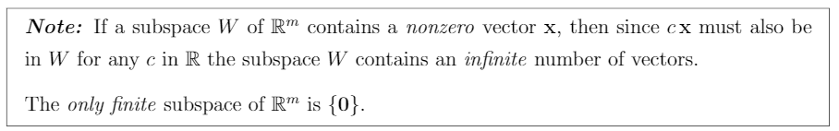
Subspace nonzero Vector

Slide 7

Subspace and Span

Slide 8
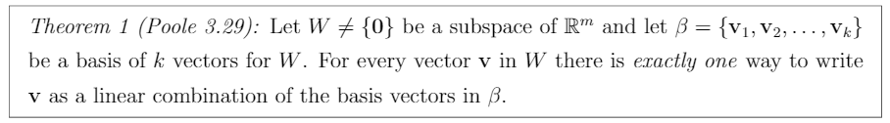
Basis and Span

Slide 9
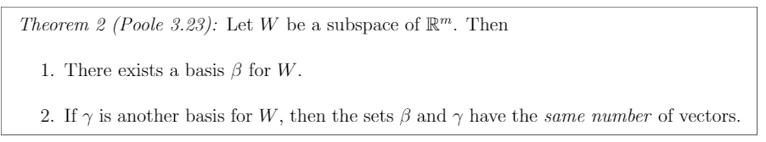
Dupe Subspaces

Slide 10
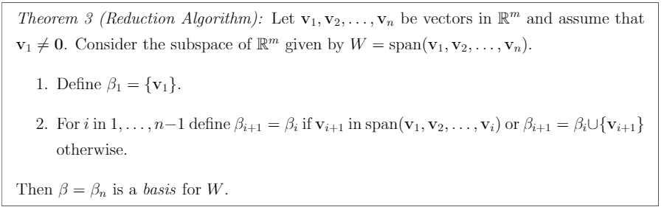
Reduction Algorithm

Slide 11
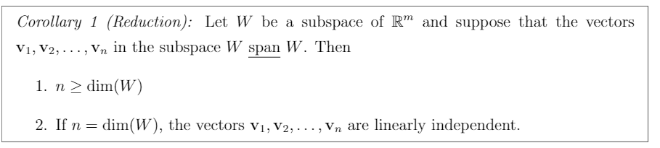
Reduction Corollary

Slide 12
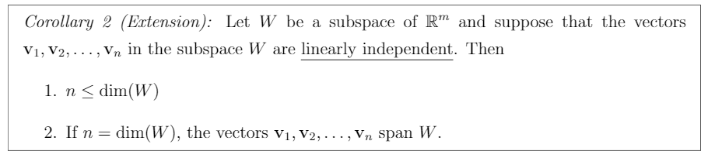
Extension Corollary

Slide 13
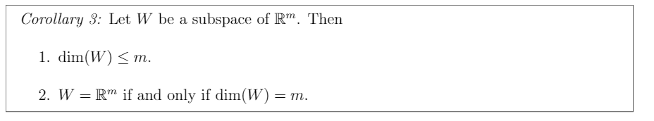
Subspace Properties

Slide 14
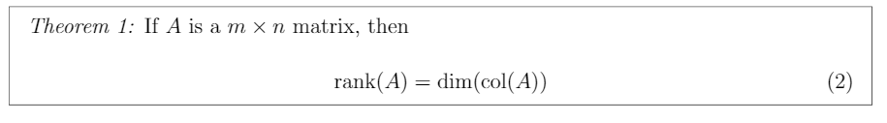
Rank & Column Dimension

Slide 15
Null and Subspace

Slide 16
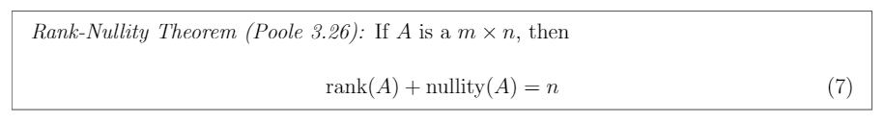
Rank Nullity Theorem

Slide 17
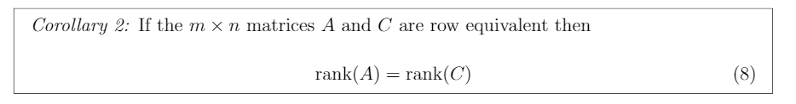
Row Equivalent Rank

Slide 18
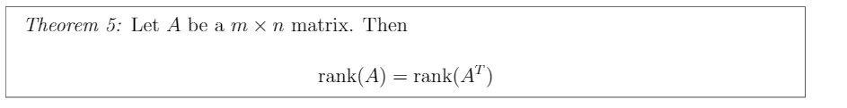
Rank vs Rank Transpose

